Slide 1
Plant sterols and heart health

Slide 2
This presentation is provided for general information purposes only. Personal health or dietary advice should always be sought for your particular circumstances from your health care professional.

Slide 3
Heart health
Heart health is important, especially as we age.
Looking after your heart health:
- maintain a healthy diet and a healthy weight
- being physically active: get some regular exercise!
- maintain healthy blood cholesterol and blood pressure
- not smoking
Notes:
It is important to look after heart health, especially as we age.
There are a number of ways we can do this:
-maintain a healthy diet and a healthy weight
-being physically active: get some regular exercise!
-monitor and maintain healthy blood cholesterol and blood pressure
-not smoking

Slide 4
What is a healthy diet?
Enjoy a variety of foods everyday
Include plenty of vegetables, fruits and legumes
Eat plenty of grain based foods, preferably wholegrain
Choose moderate amounts of lean meats, poultry and fish
Include reduced fat milks, yoghurts and cheeses
Drink plenty of water
National Health and Medical Research Council The Australian Guide to Healthy Eating, 2005
Notes:
National Health and Medical Research Council (NHMRC) Guide:
Eat plenty of vegetables, fruits and legumes (dried peas, dried beans and lentils) and grain based foods such as wholegrain or wholemeal bread, pasta (preferably wholemeal), rice (preferably brown), noodles and grains.
Eat moderate amounts of lean meats, skinless poultry, fish and choose reduced or low fat dairy products; and
Eat moderate amounts of polyunsaturated or monounsaturated oils and fats (more about this later)

Slide 5
What is a healthy weight?
BMI (body mass index): 20-25kg/m2 = healthy weight
BMI = weight(kg) / height(m2)
Waist circumference
Ideal: <94cm for a male, <80cm for females
Get regular exercise
Have a healthy diet
Notes:
Maintaining a healthy weight is important for your health.
Regular exercise and a healthy diet can help to achieve this.
You can check your weight using:
1. BMI (body mass index)= weight (kg)/height(m²)
BMI 20-25kg/m² is considered a healthy weight
2. Waist circumference
(<94cm for a male, <80cm for females)

Slide 6
Being active
Aim for ≥ 30 minutes of activity most days of the week
Start gently and build up slowly
Increase your incidental activity -take the stairs
Choose an exercise that suits you and that you enjoy
Walking the dog • cycling • gardening • dancing • golf etc
Notes:
Aim for at least 30 minutes of activity most days of the week.
Start gently and build up slowly.
Increase your incidental activity (take the stairs).
Choose an exercise that suits you and that you enjoy.
Eg. walking the dog, cycling, gardening, dancing, a hit of golf etc

Slide 7
What about cholesterol?
Cholesterol is a fatty substance
Essential in the body
Important for cell wall structure and hormones
Found in the diet and produced by the body (in the liver)
Too much cholesterol can become a problem…
2 types:
HDL “good” cholesterol
LDL “bad” cholesterol
Notes:
Cholesterol is a fatty substance
It’s essential in the body
It is important for cell wall structure and hormones in the body.
Cholesterol is found in the diet and produced by the body (in the liver)
Too much cholesterol can become a problem…
2 types
HDL “good” cholesterol
LDL cholesterol

Slide 8
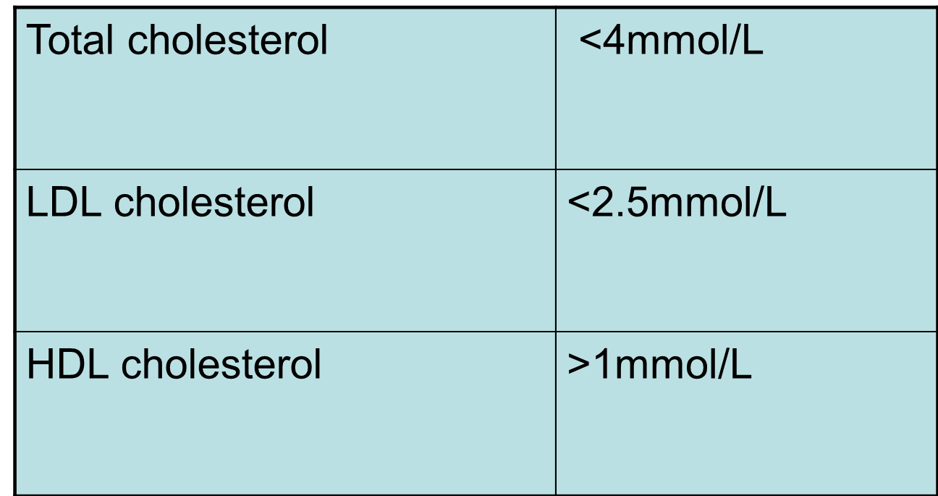
Cholesterol targets
For people concerned with heart health
The Heart Foundation of Australia 2005, Position Statement on Lipid Management
Notes:
These values represent lower targets for those with other risk factors

Slide 9
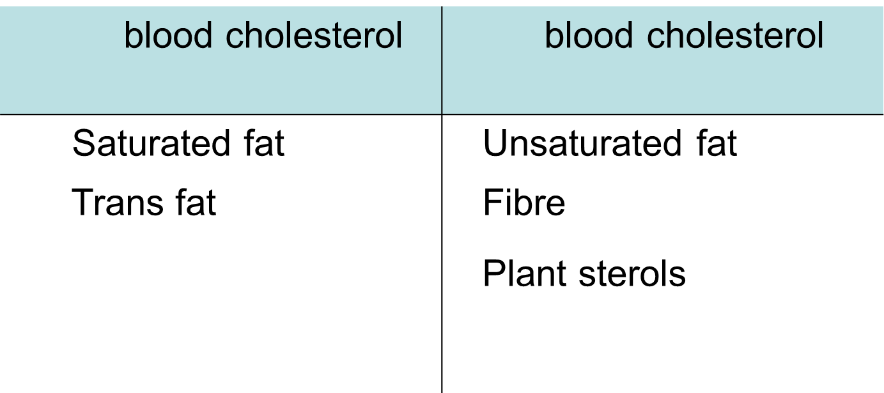
Nutrients in foods that can affect cholesterol
Dietary cholesterol plays a less important role than the type of fat
Notes:
Type of fat: saturated versus unsaturated
Fibre (oats, barley, legumes, fruits and vegetables and wholegrains)
Plant sterols
(Dietary cholesterol plays a less important role that the type of fat)

Slide 10
More on the fats…
Choose more unsaturated fats including:
Canola, olive, sunflower, safflower, soybean oils / seeds
Nuts and avocado
Oily fish
Reduce saturated fats and trans fats by:
Choosing lean meats and limit fatty meats
Use low and reduced fat dairy products
Limit take-away foods such as pastries, pies, pizza and fried foods
Limit snack foods such as chips, cakes, chocolates and biscuits
Notes:
Choose more unsaturated fats (mono and poly-unsaturated) to help decrease cholesterol. These foods include:
Canola, olive, sunflower, safflower, soybean oils / seeds
Nuts and avocado
Oily fish
Reduce Saturated fats and trans fats as they can contribute to increasing cholesterol. To limit these:
Choose lean meats and limit fatty meats
Use low and reduced fat dairy products
Limit take-away foods such as pastries, pies, pizza and fried foods
Limit snack foods such as chips, cakes, chocolates and biscuits

Slide 11
Plant sterols - what are they?
Occur naturally in plant foods such as nuts, seeds, legumes, fruits and vegetables
Have a similar structure to cholesterol
Compete with cholesterol for absorption in the body
Notes:
Occur naturally in plant foods such as nuts, seeds, legumes, fruits and vegetables
Typical diet contains 160-400mg/day
Complete with cholesterol for absorption in the body
Consuming 2-3g/day can result in less cholesterol, particularly LDL cholesterol, absorbed in the body

Slide 12
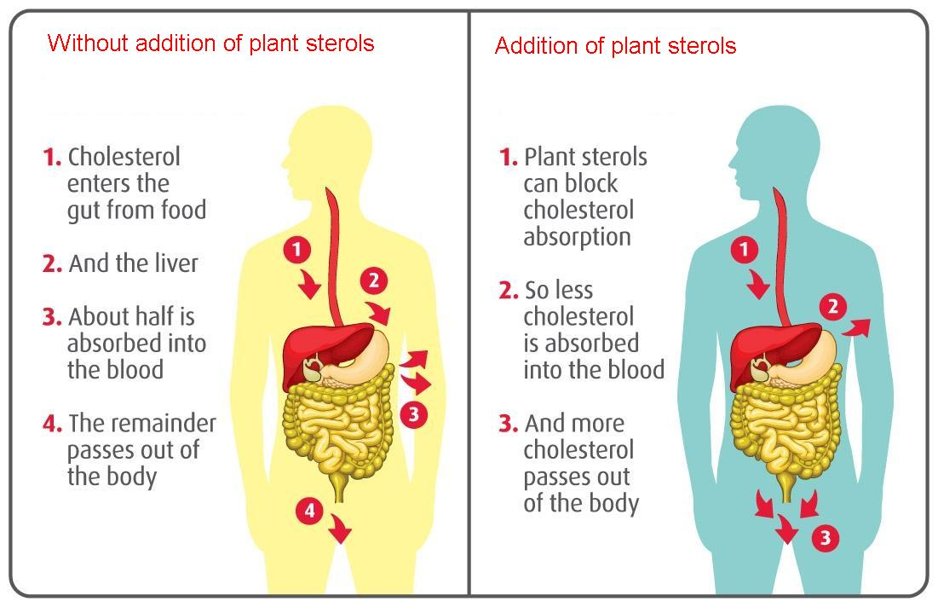
Plant sterols - how do they work?
Notes:
Plant sterols have a similar structure to cholesterol (but are mainly unabsorbed in the gut)
They compete with cholesterol for absorption in the body
This results in less cholesterol absorbed and more passes out of the body
= lower total cholesterol, including LDL cholesterol, with little impact on HDL cholesterol

Slide 13
Plant sterols - what are the benefits?
Can lower total cholesterol, including LDL cholesterol, with little impact on HDL Cholesterol
Consuming plant sterol enriched milk every day can lower LDL cholesterol by an average of 10% in three week*
*Clifton, P et al (2004) EJCN 58, 503-509.

Slide 14
Plant Sterols - how much do I need?
Typical diet contains 160-400mg/day
The Heart Foundation of Australia recommends 2-3 grams of plant sterols/day
> 3 grams/day provides no additional benefit
0.8g plant sterol
250ml PURA HeartActive
2.4g plant sterols
Notes:
The Heart Foundation of Australia recommends a daily intake of 2-3grams of plant sterols to effectively lower cholesterol
This can be achieved from plant sterol fortified-foods such as low fat milk
For example, each 250ml serve of Pura Heart Active contains 0.8g of plant sterols.
Consuming this 2-3 times a day would meet the Heart Foundation of Australia’s recommendation.
Consuming in excess of 3 grams per day is not thought to give additional benefit

Slide 15
Plant sterols - can everyone use them?
Yes, but….
children under the age of 5 years and pregnant or lactating women should consult their doctor before using plant sterol products. This is because these people may have special dietary needs.

Slide 16
Plant sterols - what about cholesterol medication?
In general, the effect of plant sterols will be additive to most cholesterol lowering medication*. However you should review this first with your GP.
*Thomsen (2004) EJCN 58, 860-70.

Slide 17
Plant sterols - where can I get more information?
The Heart Foundation of Australia
Position statement on dietary fats and dietary sterols www.heartfoundation.com.au
HeartActive www.heartactive.com.au
Better Health Channel www.betterhealth.vic.gov.au

